Slide 1

Chapter 9
Simple Linear Regression

Slide 2
Contents
Simple Linear Regression Model
Least Squares Method
Coefficient of Determination
Model Assumptions
Estimation for β1
Confidence interval & Prediction interval estimation

Slide 3
Simple Linear Regression
Managerial decisions often are based on the relationship between two or more variables.
Regression analysis can be used to develop an equation showing how the variables are related.
The variable being predicted is called the dependent variable and is denoted by y.
The variables being used to predict the value of the dependent variable are called the independent variables and are denoted by x.

Slide 4
Simple Linear Regression
Simple linear regression involves one independent variable and one dependent variable.
The relationship between the two variables is approximated by a straight line.
Regression analysis involving two or more independent variables is called multiple regression.

Slide 5
Simple Linear Regression Model
The equation that describes how y is related to x and an error term is called the regression model.
The simple linear regression model is:
y = β₀ + β₁x + ε
where:
β₀ and β₁ are called parameters of the model,
ε is a random variable called the error term.

Slide 6
Simple Linear Regression Equation
The simple linear regression equation is:
E(y) = β₀ + β₁x
Graph of the regression equation is a straight line.
β₀ is the y intercept of the regression line.
β₁ is the slope of the regression line.
E(y) is the expected value of y for a given x value.

Slide 7
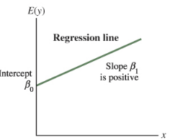
Simple Linear Regression Equation
Positive Linear Relationship

Slide 8
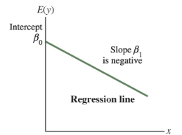
Simple Linear Regression Equation
Negative Linear Relationship

Slide 9
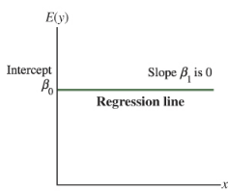
Simple Linear Regression Equation
No Relationship

Slide 10
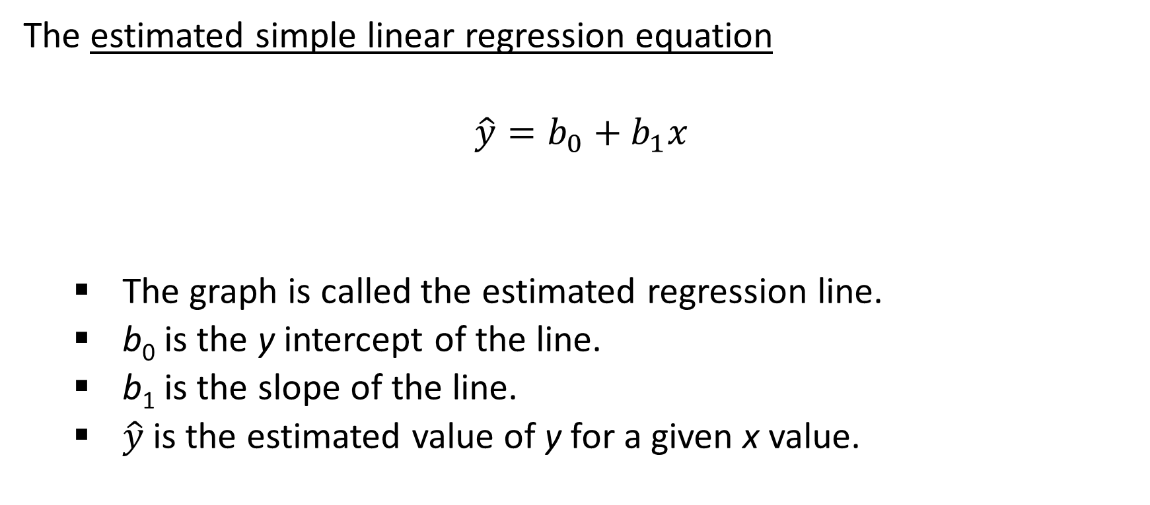
Estimated Simple Linear Regression Equation
The estimated simple linear regression equation
$$\hat{y}=b_{0}+b_{1}x$$
The graph is called the estimated regression line.
b₀ is the y intercept of the line.
b₁ is the slope of the line.
$\hat{y}$is the estimated value of y for a given x value.

Slide 11
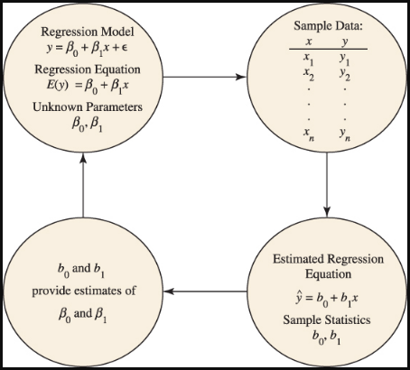
Estimation Process

Slide 12
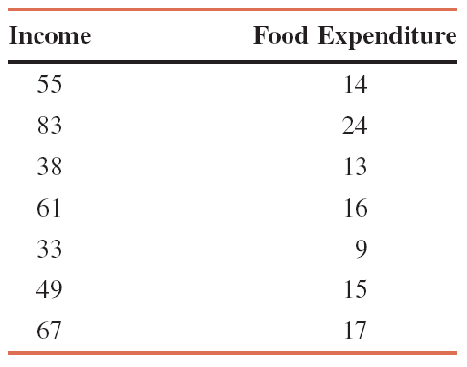
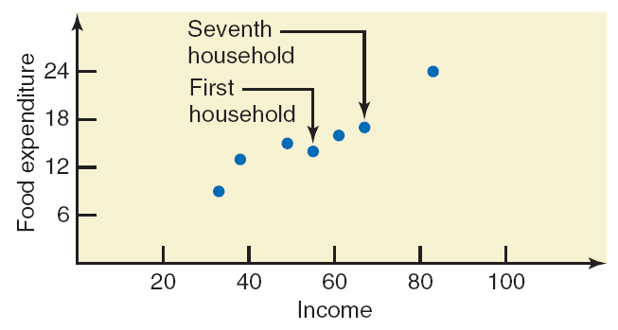
Example: Incomes (in hundreds of dollars) and Food Expenditures of Seven Households

Slide 13
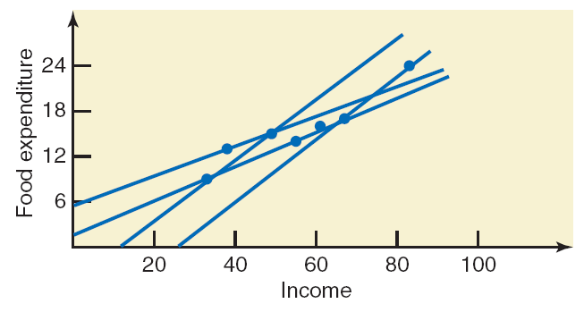
Example: Incomes (in hundreds of dollars) and Food Expenditures of Seven Households
In regression analysis, we try to find a line that best fits the points in the scatter diagram. Such a line provides a best possible description of the relationship between the dependent and independent variables.

Slide 14
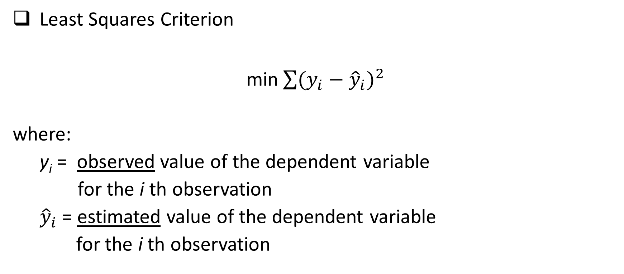
Least Squares Method
Least Squares Criterion
min$\sum{{(y_{i}−{\hat{y}}_{i})}^{2}}$
where:
y_{i} = observed value of the dependent variable
for the i th observation
${\hat{y}}_{i}$ = estimated value of the dependent variable
for the i th observation

Slide 15
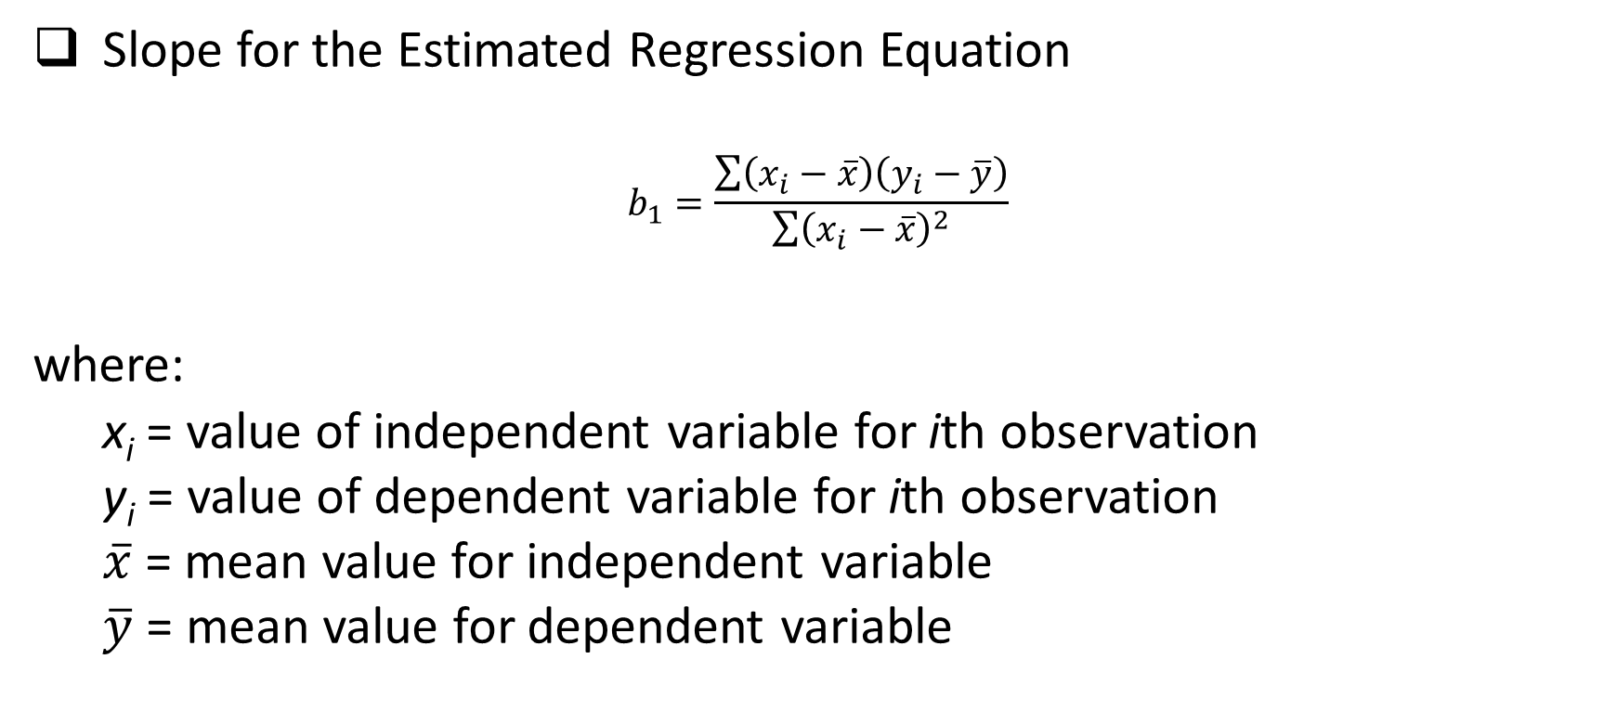
Least Squares Method
Slope for the Estimated Regression Equation
$$b_{1}=\frac{\sum{\left(x_{i}−\overline{x}\right)\left(y_{i}−\overline{y}\right)}}{\sum{{\left(x_{i}−\overline{x}\right)}^{2}}}$$
where:
x_{i} = value of independent variable for ith observation
y_{i} = value of dependent variable for ith observation
$\overline{x}$= mean value for independent variable
$\overline{y}$ = mean value for dependent variable

Slide 16

Least Squares Method
y-Intercept for the Estimated Regression Equation
$$b_{0}=\overline{y}−b_{1}\overline{x}$$

Slide 17
Simple Linear Regression
Example: Armand’s Pizza Parlor Restaurants
Data was collected from a sample of 10 Armand’s Pizza Parlor Restaurants near college campuses. For the ith observation or restaurant in the sample, x_{i} is the size of the student population and y_{i} is the quarterly sales.

Slide 18
Simple Linear Regression
Example: Armand’s Pizza Parlor Restaurants
Restaurant | Student population (1000s) | Quarterly sales ($1000s)
1 | 2 | 58
2 | 6 | 105
3 | 8 | 88
4 | 8 | 118
5 | 12 | 117
6 | 16 | 137
7 | 20 | 157
8 | 20 | 169
9 | 22 | 149
10 | 26 | 202

Slide 19
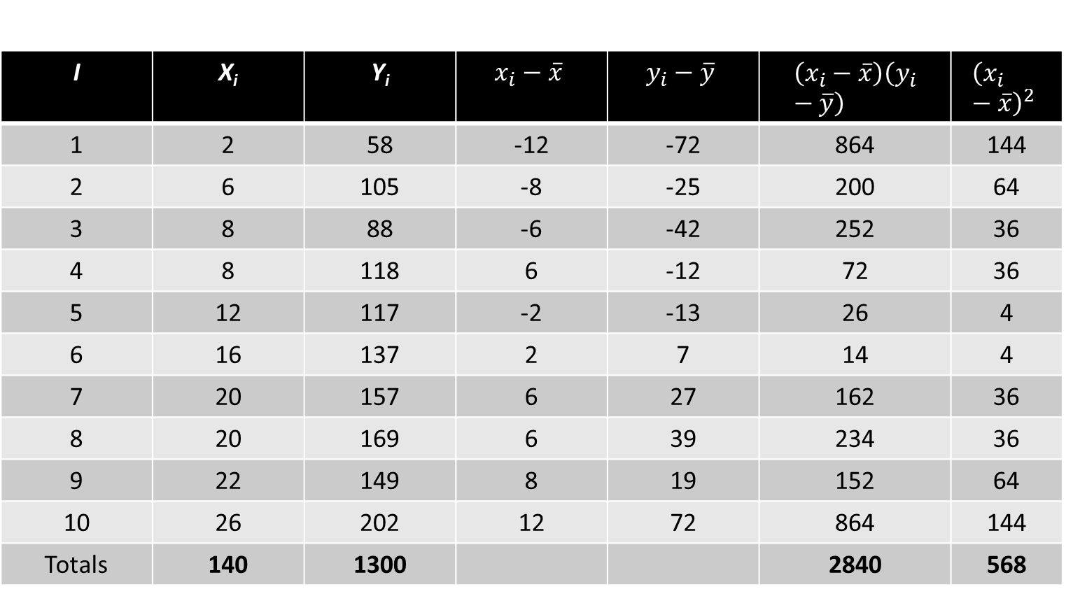
Simple Linear Regression
I | X_{i} | Y_{i} | $$x_{i}−\overline{x}$$ | $$y_{i}−\overline{y}$$ | $$\left(x_{i}−\overline{x}\right)\left(y_{i}−\overline{y}\right)$$ | $${\left(x_{i}−\overline{x}\right)}^{2}$$
1 | 2 | 58 | -12 | -72 | 864 | 144
2 | 6 | 105 | -8 | -25 | 200 | 64
3 | 8 | 88 | -6 | -42 | 252 | 36
4 | 8 | 118 | 6 | -12 | 72 | 36
5 | 12 | 117 | -2 | -13 | 26 | 4
6 | 16 | 137 | 2 | 7 | 14 | 4
7 | 20 | 157 | 6 | 27 | 162 | 36
8 | 20 | 169 | 6 | 39 | 234 | 36
9 | 22 | 149 | 8 | 19 | 152 | 64
10 | 26 | 202 | 12 | 72 | 864 | 144
Totals | 140 | 1300 |  |  | 2840 | 568
Example:
Armand’s
Pizza Parlor
Restaurants

Slide 20
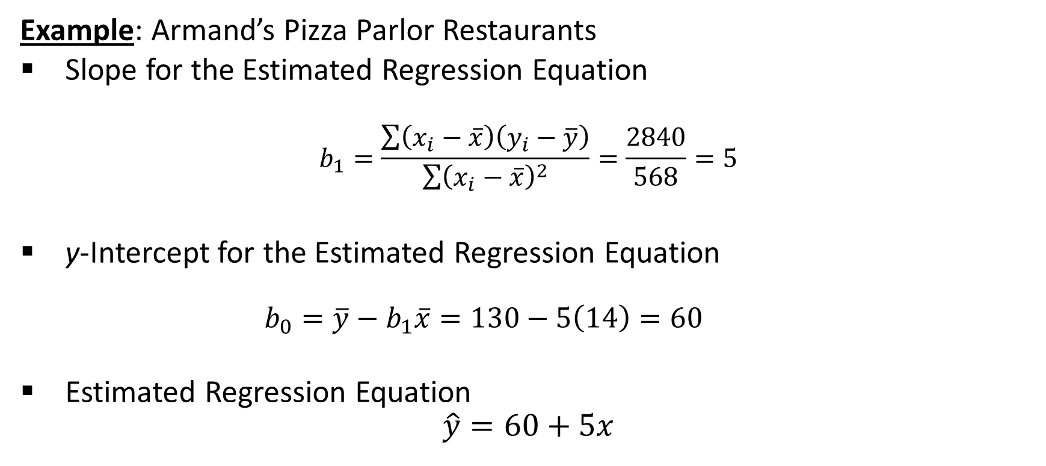
Simple Linear Regression
Example: Armand’s Pizza Parlor Restaurants
Slope for the Estimated Regression Equation
$$b_{1}=\frac{\sum{\left(x_{i}−\overline{x}\right)\left(y_{i}−\overline{y}\right)}}{\sum{{\left(x_{i}−\overline{x}\right)}^{2}}}=\frac{2840}{568}=5$$
y-Intercept for the Estimated Regression Equation
$$b_{0}=\overline{y}−b_{1}\overline{x}=130−5\left(14\right)=60$$
Estimated Regression Equation
$$\hat{y}=60+5x$$

Slide 21
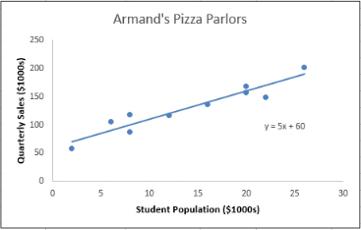
Using Excel’s Chart Tools for Scatter Diagram & Estimated Regression Equation
Example: Armand’s Pizza Parlor Restaurants

Slide 22
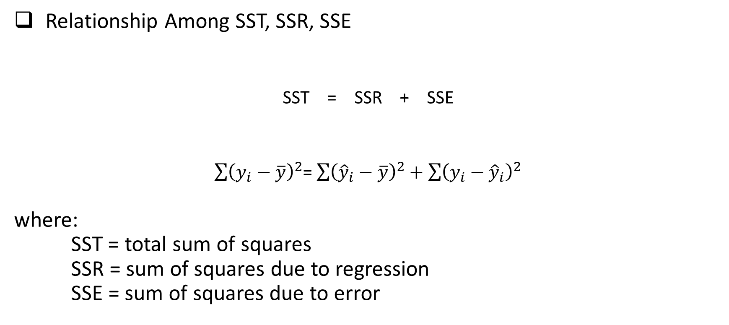
Coefficient of Determination
Relationship Among SST, SSR, SSE
SST = SSR + SSE
$\sum{{\left(y_{i}−\overline{y}\right)}^{2}}$= $\sum{{\left({\hat{y}}_{i}−\overline{y}\right)}^{2}+\sum{{\left(y_{i}−{\hat{y}}_{i}\right)}^{2}}}$
where:
SST = total sum of squares
SSR = sum of squares due to regression
SSE = sum of squares due to error

Slide 23
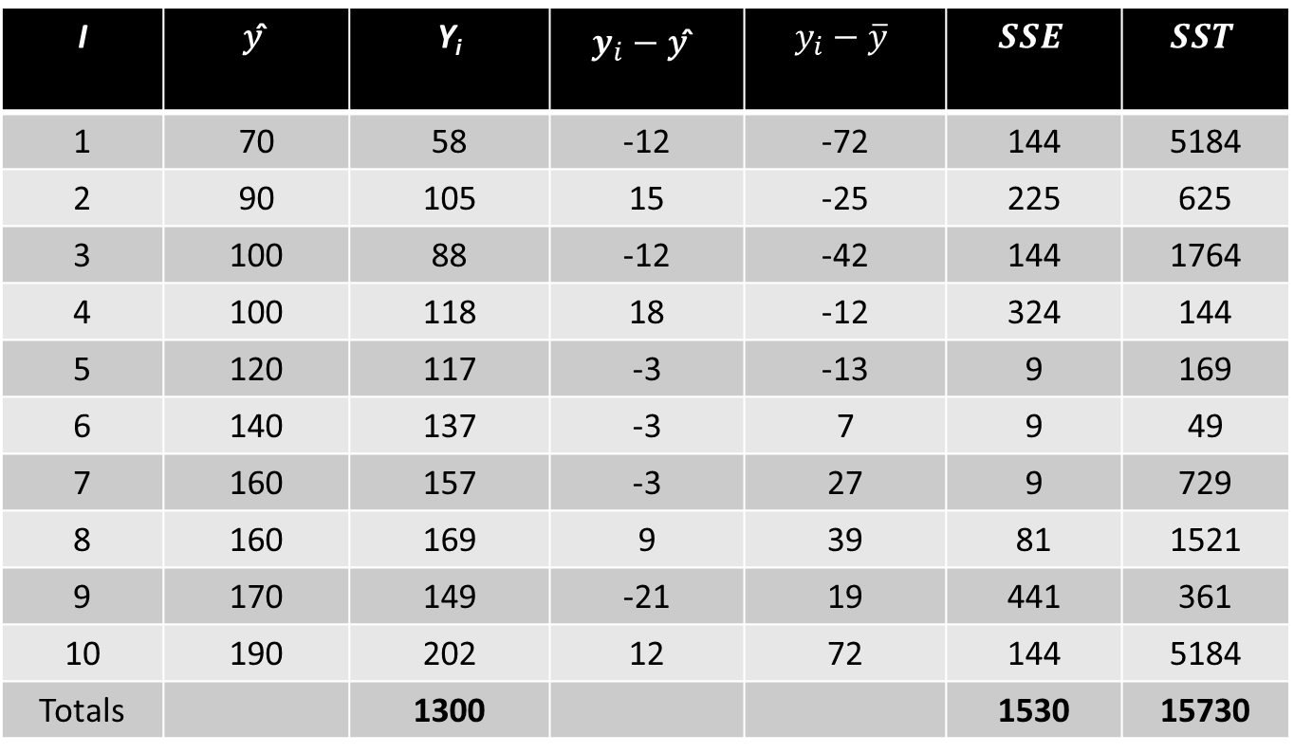
Coefficient of Determination
I | 𝑦 ̂ | Y_{i} | $$y_{i}−\text{y}\text{ ̂}$$ | $$y_{i}−\overline{y}$$ | $$SSE$$ | $$SST$$
1 | 70 | 58 | -12 | -72 | 144 | 5184
2 | 90 | 105 | 15 | -25 | 225 | 625
3 | 100 | 88 | -12 | -42 | 144 | 1764
4 | 100 | 118 | 18 | -12 | 324 | 144
5 | 120 | 117 | -3 | -13 | 9 | 169
6 | 140 | 137 | -3 | 7 | 9 | 49
7 | 160 | 157 | -3 | 27 | 9 | 729
8 | 160 | 169 | 9 | 39 | 81 | 1521
9 | 170 | 149 | -21 | 19 | 441 | 361
10 | 190 | 202 | 12 | 72 | 144 | 5184
Totals |  | 1300 |  |  | 1530 | 15730

Slide 24
Coefficient of Determination
The coefficient of determination is:
r² = SSR/SST
where:
SSR = sum of squares due to regression
SST = total sum of squares

Slide 25
Coefficient of Determination
Example: Armand’s Pizza Parlor Restaurants
r² = SSR/SST = 14,200/15,730 = .9027
The regression relationship is very strong; 90.27% of the variability in the sales can be explained by the linear relationship between the size of the student population and sales.

Slide 26
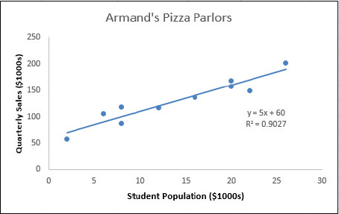
Using Excel to Compute the Coefficient of Determination
Example: Armand’s Pizza Parlor Restaurants
Adding r ² Value to Scatter Diagram

Slide 27

Sample Correlation Coefficient
$$r_{xy}=(sign of b_{1})\sqrt{Coefficient of Determination}$$
$$r_{xy}=(sign of b_{1}) \sqrt{r^{2}}$$
where:
b₁ = the slope of the estimated regression equation
$$\hat{y}=b_{0}+b_{1}x$$

Slide 28

Sample Correlation Coefficient
Example: Armand’s Pizza Parlor Restaurants
$$r_{xy}=(sign of b_{1}) \sqrt{r^{2}}$$
The sign of b₁ in the equation $\hat{y} \text{= }\text{6}\text{0 + 5}\text{x} \text{is}\text{ "+"}.$
$$r_{xy}=+\sqrt{.9027}$$
r_{xy} = +.9051

Slide 29
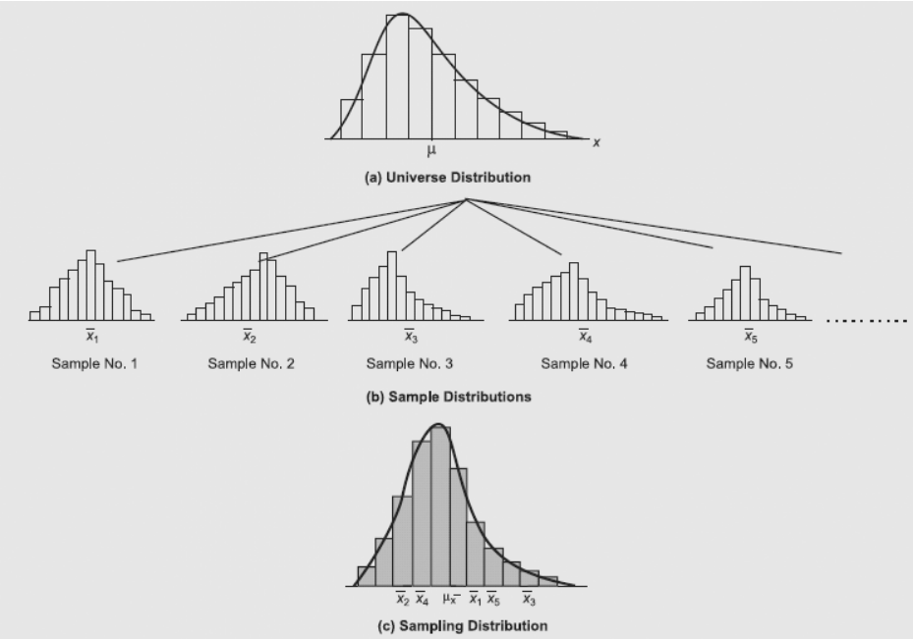
Sampling Distribution of 𝑥 ̅
(recap)

Slide 30
Assumptions About the Regression Model (population)
Model assumptions
1. The random error term ε has a mean equal to zero for each x.
2. The errors associated with different observations are independent.
3. For any given x, the distribution of errors is normal.
4. The distribution of population errors for each x has the same (constant) standard deviation, which is denoted σ_{ε}.

Slide 31
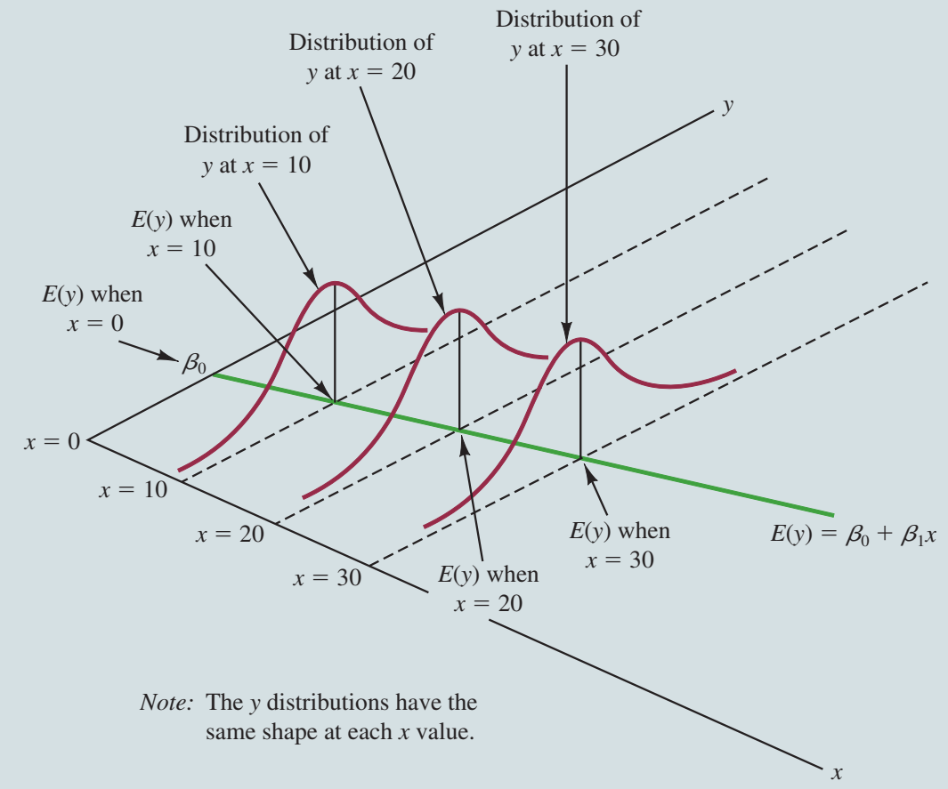
Assumptions About the Regression Model (population)

Slide 32

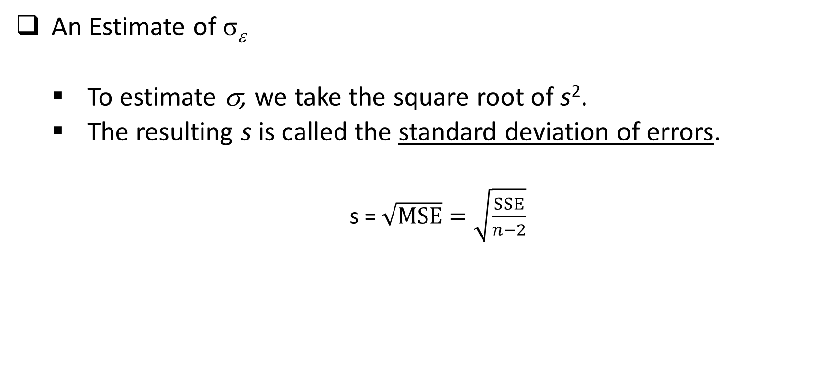
Estimate of standard deviation of errors
An Estimate of σ_{ε}
To estimate σ, we take the square root of s².
The resulting s is called the standard deviation of errors.
s = $\sqrt{MSE}=\sqrt{\frac{SSE}{n−2}}$

Slide 33
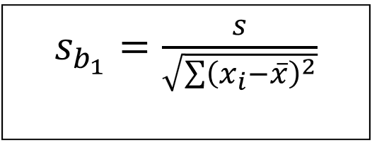
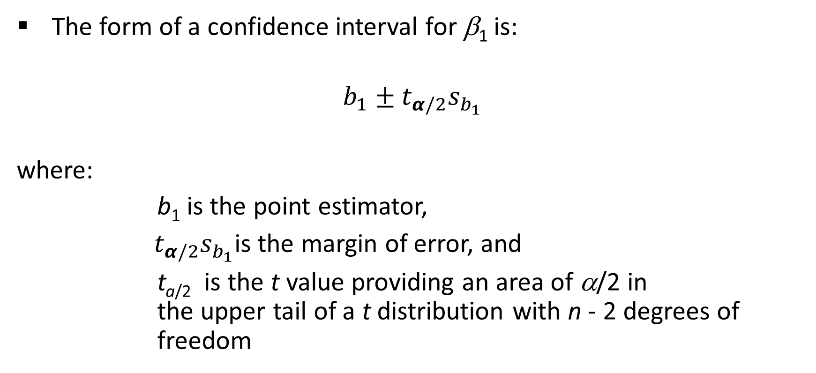
Confidence Interval for β₁
The form of a confidence interval for β₁ is:
$$b_{1}±t_{α/2}s_{b_{1}}$$
where:
b₁ is the point estimator,
${ t}_{α/2}s_{b_{1}}$is the margin of error, and
t_{a/2} is the t value providing an area of α/2 in the upper tail of a t distribution with n - 2 degrees of freedom

Slide 34

Confidence Interval for β₁
99% Confidence Interval for β₁
$b_{1}±t_{α/2}s_{b_{1}}$= 5 $±$ 3.355 (.5803) = 5 $±$ 1.95
or 3.05 to 6.95

Slide 35
Using the Estimated Regression Equation for Estimation and Prediction
A confidence interval is an interval estimate of the mean value of y for a given value of x.
A prediction interval is used whenever we want to predict an individual value of y for a new observation corresponding to a given value of x.
The margin of error is larger for a prediction interval.

Slide 36

Using the Estimated Regression Equation for Estimation and Prediction
Confidence Interval Estimate of E(y*)
$${\hat{y}}^{∗}±t_{α/2}s_{{\hat{y}}^{∗}}$$
Prediction Interval Estimate of y*
$${\hat{y}}^{∗}±t_{α/2}s_{pred}$$
where:
confidence coefficient is 1 - α and t_{α/2} is based on a t distribution with n - 2 degrees of freedom.

Slide 37
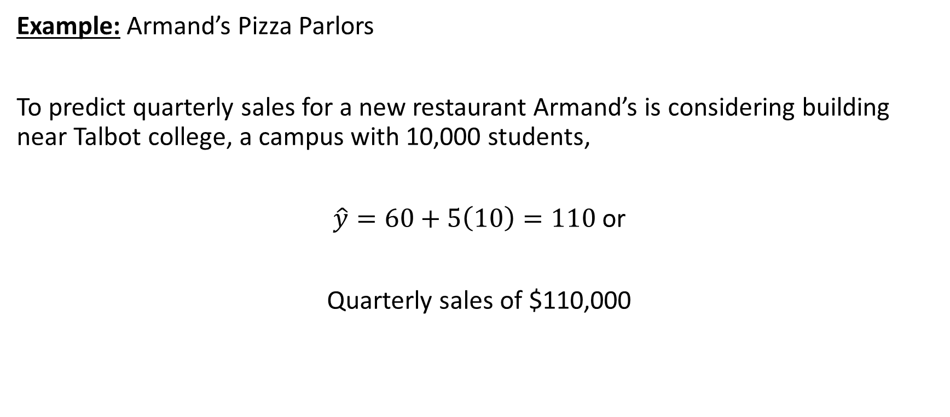
Point Estimation
Example: Armand’s Pizza Parlors
To predict quarterly sales for a new restaurant Armand’s is considering building near Talbot college, a campus with 10,000 students,
$\hat{y}=60+5\left(10\right)=110$ or
Quarterly sales of $110,000

Slide 38
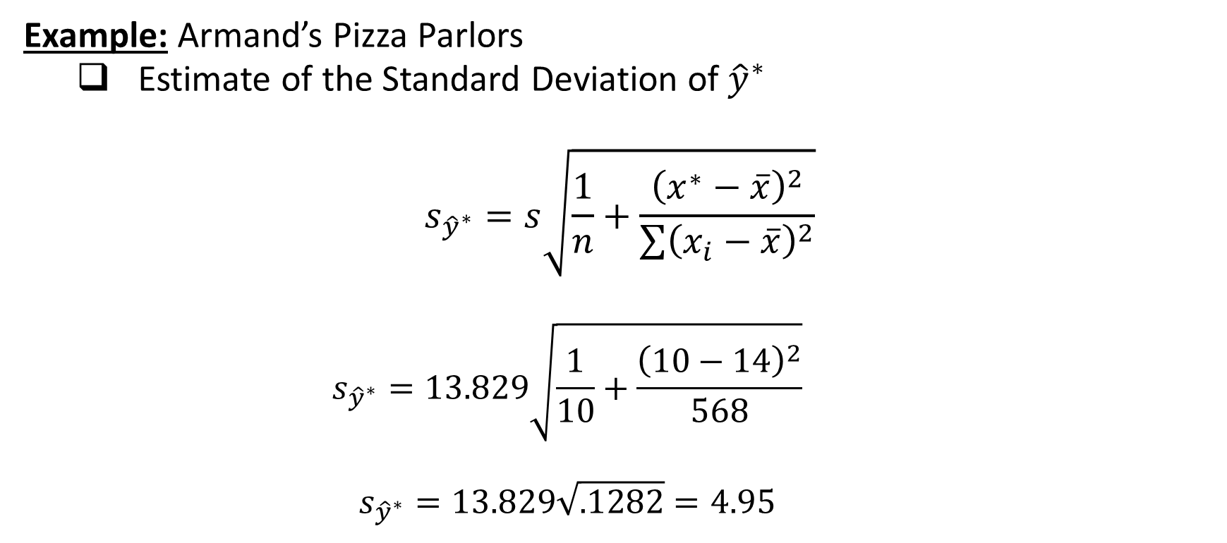
Confidence Interval for E(y*)
Example: Armand’s Pizza Parlors
Estimate of the Standard Deviation of ${\hat{y}}^{∗}$
$$s_{{\hat{y}}^{∗}}=s\sqrt{\frac{1}{n}+\frac{{\left(x^{∗}−\overline{x}\right)}^{2}}{\sum{{\left(x_{i}−\overline{x}\right)}^{2}}}}$$
$$s_{{\hat{y}}^{∗}}=13.829\sqrt{\frac{1}{10}+\frac{{\left(10−14\right)}^{2}}{568}}$$
$$s_{{\hat{y}}^{∗}}=13.829\sqrt{.1282}=4.95$$

Slide 39
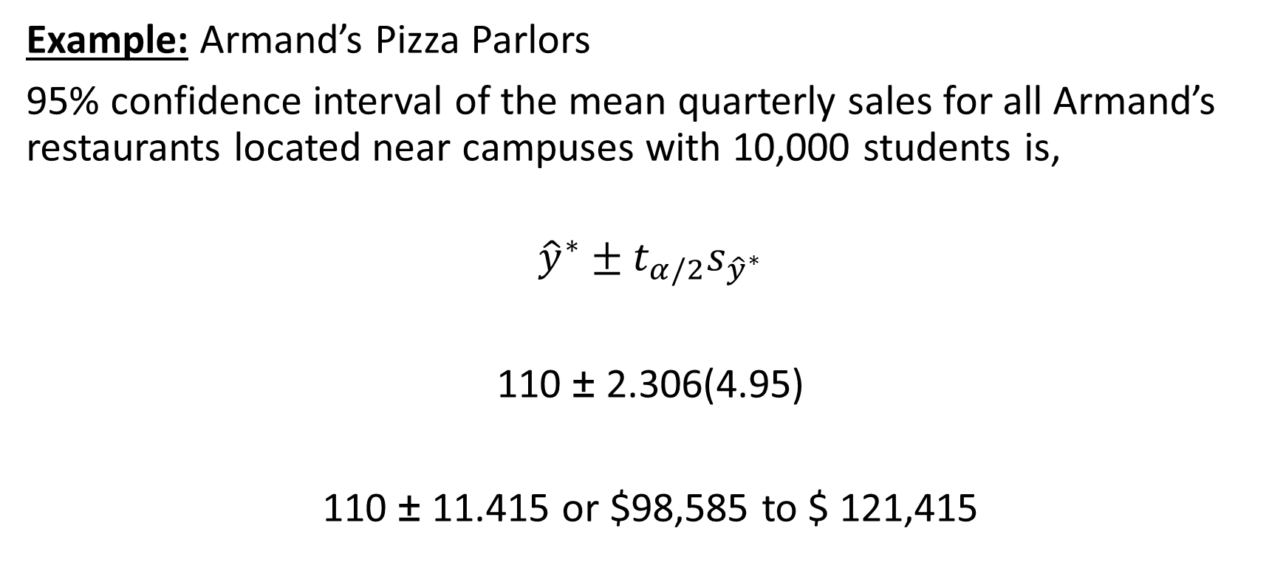
Confidence Interval for E(y*)
Example: Armand’s Pizza Parlors
95% confidence interval of the mean quarterly sales for all Armand’s restaurants located near campuses with 10,000 students is,
$${\hat{y}}^{∗}±t_{α/2}s_{{\hat{y}}^{∗}}$$
110 ± 2.306(4.95)
110 ± 11.415 or $98,585 to $ 121,415

Slide 40

Prediction Interval for y*
Example: Armand’s Pizza Parlors
Estimate of the Standard Deviation of an Individual Value of y*
$$s_{pred}=s\sqrt{1+\frac{1}{n}+\frac{{\left(x^{∗}−\overline{x}\right)}^{2}}{\sum{{\left(x_{i}−\overline{x}\right)}^{2}}}}$$
$$s_{pred}=13.829\sqrt{1+\frac{1}{10}+\frac{\left(10 −14\right)2}{568}}$$
s_{pred} = $13.829\sqrt{1.282 }$
= 14.69

Slide 41
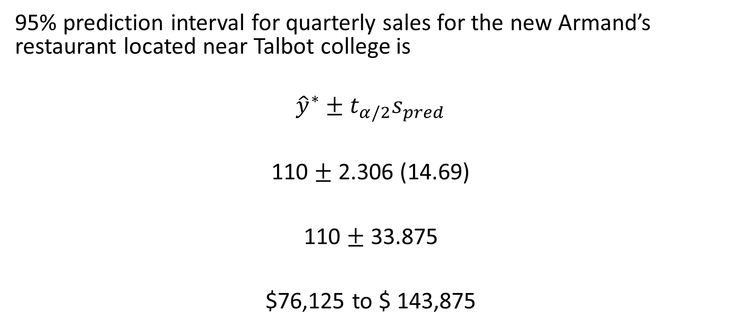
Prediction Interval for y*
95% prediction interval for quarterly sales for the new Armand’s restaurant located near Talbot college is
$${\hat{y}}^{∗}±t_{α/2}s_{pred}$$
110 $±$ 2.306 (14.69)
110 $±$ 33.875
$76,125 to $ 143,875

Slide 42
Question for Practice
A sales manager collected data on annual sales for new customer accounts and the number of years of experience for a sample of 10 salespersons. The data is shown in the datafile Sales.
Develop a scatter diagram for these data with years of experience as the independent variable.
Develop an estimated regression equation that can be used to predict annual sales given the years of experience.
Use the estimated regression equation to predict annual sales for a salesperson with 9 years of experience.

Slide 43
Question for Practice
Compute r² and explain.
Construct a 95% confidence interval for β₁.
Develop a 95% confidence interval for the mean annual sales for all salespersons with nine years of experience.
The company is considering hiring Tom Smart, a salesperson with nine years of experience. Develop a 95% prediction interval of annual sales for Tom Smart.
Discuss the differences in your answers of the last two parts.

